Slide 1
Behavioural & Experimental Economics Rational Choice under Risk & Uncertainty
Lunzheng Li
University of Cyprus

Slide 2
Course Outline
Choice under Certainty
Judgement under Risk & Uncertainty
Choices under Risk & Uncertainty
Intertemporal Choice
Strategic Interaction

Slide 3
Course Outline
Choice under Certainty
Judgement under Risk & Uncertainty
Choices under Risk & Uncertainty
Rational Choice under Risk & Uncertainty
Decision-making under Risk & Uncertainty
Intertemporal Choice
Strategic Interaction

Slide 4
Risk vs. Uncertainty
In choice under certainty, risk and uncertainty are not an issue.
A choice under uncertainty is made when the probabilities of the relevant outcomes are unknown or not meaningful.
A choice under risk is made when the probabilities of the outcomes are meaningful and known.

Slide 5
Uncertainty

Slide 6
Example
You leave your house in the morning and have to decide whether to take an umbrella or leave it at home.
There are different possible states of the world: Rain, No Rain.
The outcome depends on your choice AND the state of the world.
 | Rain | No Rain
Take umbrella | Dry, not happy | Dry, not happy
Leave umbrella | Wet, miserable | Dry, happy
 | Rain | No Rain
Take umbrella | 3 | 3
Leave umbrella | 0 | 5
Utility payoffs

Slide 7
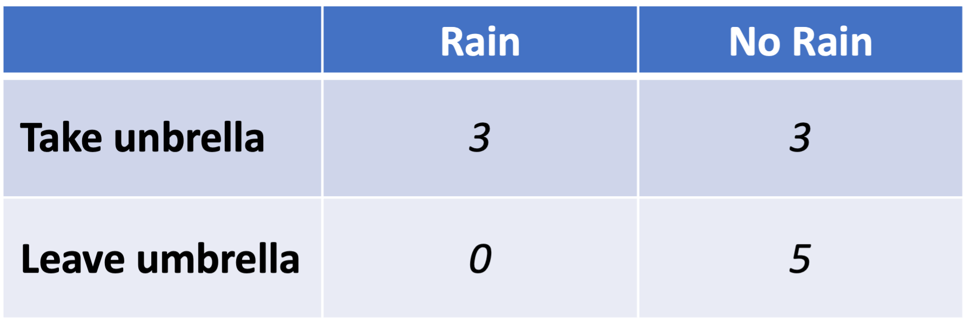
maximin criterion
The maximin criterion says the best choice is the one with the greatest minimum utility payoff. (Maximin = the maximum minimum.)RainNo R
Take umbrella

Slide 8
maximax criterion
The maximax criterion says the best choice is the one with the greatest maximum utility payoff. (Maximax = maximum maximum.)
Leave umbrella

Slide 9
minimax-risk/regret criterion
The minimax-risk/regret criterion says the best choice is the one that minimizes the maximum risk or regret. The regret equals the best payoff you could have had if you had acted differently, minus your actual payoff. The choice with the least maximum regret is the one to choose.
 | Rain | No Rain
Take umbrella | 0 | 2
Leave umbrella | 3 | 0
Take umbrella

Slide 10
maximin criterion
maximax criterion
minimax-risk/regret criterion
Overly cautious!
Overly reckless!
In between
All are rational: like with preferences, different people may use different criteria.

Slide 11
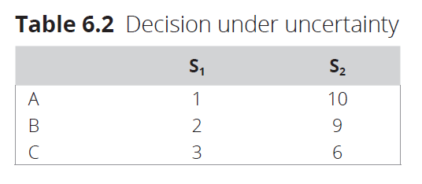
Example
What is the maximin strategy?
What is the maximax strategy?
What is the minimax-risk strategy?

Slide 12
Discuss
Does it seem reasonable to always use a criterion like maximin?
Consider the following two scenarios:
 | S₁ | S₂
A | 1 | 1
B | 0 | 10
 | S₁ | S₂
A | 1 | 1
B | 0 | 10,000,000
Scenario 1
Scenario 2

Slide 13
Expected Value

Slide 14
Choice under Risk
When it is possible and meaningful to assign probabilities to different states, enter the realm of Choice under Risk.
We can describe decision problems as choices over gambles/lotteries.
Example of a simple gamble: I flip a coin and if it comes up Heads you win €10, if Tails you win €0
H
1/2
€10
 | H | T
Offer | €10 | €0
1/2
€0
T

Slide 15
Expected value of a gamble
Expected Value of a gamble is what you can expect to win on average in the long run, when you play the gamble.
The expected Value of the simple gamble from before is
H
1/2
€10
EV(gamble) = ½ €10 + ½ €0 = €5
1/2
€0
T

Slide 16
Choice between gambles
You have the choice of accepting the simple gamble or rejecting it and getting €4.
H
1/2
€10
A
1/2
€0
T
€4
R
T

Slide 17
Choice between gambles
You have the choice of accepting the simple gamble or rejecting it and getting €4.
H
H
1/2
€10
1/2
€10
A
A
1/2
1/2
€0
€0
T
T
H
€4
1/2
€4
R
R
1/2
T
€4

Slide 18
Choice between gambles
You have the choice of accepting the simple gamble or rejecting it and getting €4.
H
H
1/2
€10
1/2
€10
A
A
S | H | T
Pr(S) | ½ | ½
Accept | €10 | €0
Reject | €4 | €4
1/2
1/2
€0
€0
T
T
H
€4
1/2
€4
R
R
1/2
T
€4

Slide 19
Choice between gambles
What is the expected value of Accepting?
EV(Accept) = Pr(H) * π(Α,Η) + Pr(Τ) * π(Α,Τ)
= ½ €10 + ½ €0
= €5
1/2
S | H | T
Pr(S) | ½ | ½
Accept | €10 | €0
Reject | €4 | €4
EV(Reject) = Pr(H) * π(R,Η) + Pr(Τ) * π(R,Τ)
= ½ €4 + ½ €4
= €4
T

Slide 20
Exercise
If a parking ticket (from parking illegally) costs €30 and it costs €5 to park legally, what does the probability of getting a ticket need to be for the expected value of parking legally to equal the expected value of parking illegally?

Slide 21
Exercise
If a parking ticket (from parking illegally) costs €30 and it costs €5 to park legally, what does the probability of getting a ticket need to be for the expected value of parking legally to equal the expected value of parking illegally?
First assume that the probability of getting a ticket is p.
EV(legally) = -5
EV(illegally) = p * (-30)

Slide 22
Exercise
If a parking ticket (from parking illegally) costs €30 and it costs €5 to park legally, what does the probability of getting a ticket need to be for the expected value of parking legally to equal the expected value of parking illegally?
First assume that the probability of getting a ticket is p.
EV(legally) = -5
EV(legally) = EV(illegally) ⬄ -5 = p*(-30) ⬄ p = 1/6
EV(illegally) = p * (-30)

Slide 23
St Petersburg paradox
I flip a coin, and your payoff depends on how many times it takes to obtain heads: if it takes only one time, your payoff is €2, if it takes two times, your payoff is €4, three times your payoff is €8, etc.
Sounds good? What is the expected value?
How much would you be willing to pay for taking this gamble?
 | HH | TH | TTH | …
St Petersburg Gamble (SPG) | €2 | €4 | €8 | …

Slide 24
St Petersburg paradox
I flip a coin and your payof depends on how many times it takes to obtain heads: if it takes only one time, your payoff is €2, if it takes two times your payoff is €4, three times your payoff is €8, etc.
Sounds good? What is the expected value?
How much would you be willing to pay for taking this gamble?
 | HH | TH | TTH | …
St Petersburg Gamble (SPG) | €2 | €4 | €8 | …
EV(SPG) = 1/2*€2 + 1/4*€4 + 1/8*€8 + …
= 1 + 1 + 1 + … = €∞

Slide 25
Expected Utility

Slide 26
Money and Utility of Money
More money is better, but…
The utility from an additional euro is not always the same:
What is the utility a homeless man gets from €10?
What is the utility Elon Musk gets from €10?

Slide 27
Utility of money
u(x)
0
x

Slide 28
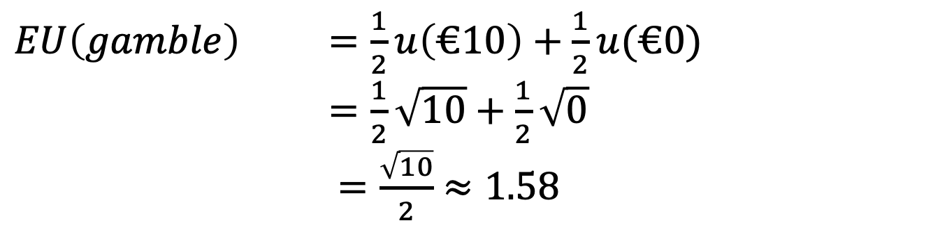

Expected utility
EU(gamble) = Pr(S₁) * u(π₁) + Pr(S₂) * u(π₂) + …+ Pr(S_{n}) * u(π_{n})
Example: suppose the utility function has the form $u\left(x\right)=\sqrt{x}$
H
1/2
€10
$EU\left(gamble\right)$ $=\frac{1}{2}u\left(€10\right)+\frac{1}{2}u(€0)$
$=\frac{1}{2}\sqrt{10}+\frac{1}{2}\sqrt{0}$
$=\frac{\sqrt{10}}{2}$ $≈1.58$
1/2
€0
T

Slide 29
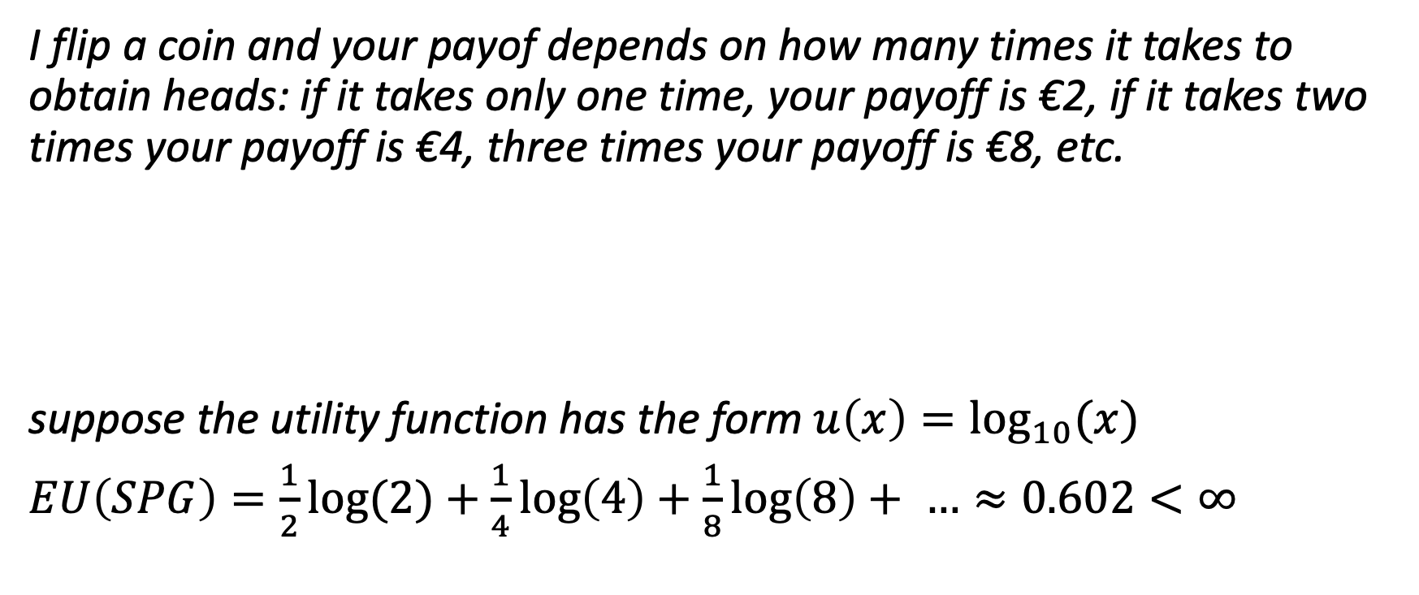
St Petersburg paradox with concave utility
I flip a coin and your payof depends on how many times it takes to obtain heads: if it takes only one time, your payoff is €2, if it takes two times your payoff is €4, three times your payoff is €8, etc.
suppose the utility function has the form $u\left(x\right)=\log_{10}{(x) }$
$EU\left(SPG\right)=\frac{1}{2}\log{(2)}+\frac{1}{4}\log\left(4\right)+\frac{1}{8}\log\left(8\right)+ …≈0.602<∞$
 | HH | TH | TTH | …
St Petersburg Gamble (SPG) | €2 | €4 | €8 | …

Slide 30
Expected utility and choice
If somebody chooses the option with the greatest expected utility, they are engaging in expected utility maximization.
Examples like the St Petersburg Paradox suggest that expected-utility maximization is a better normative AND descriptive theory than the theory of expected value.

